Slide 1
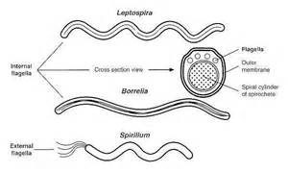
LEPTOSPIRA
Dr Sadia Ikram

Slide 2
Leptospira interrogans
Species | Disease | Mode of Transmission | Diagnosis | Morphology | Growth in Media | Treatment
Leptospira interrogans | Leptospirosis | Food or drink contaminated by urine of infected animals (rats, dogs, pigs, cows) | Serologic tests | Thin, tight spirals, seen by dark field illumination | + | Penicillin G

Slide 3
Important Properties:
Leptospira interrogans cause of leptospirosis.
Tightly coiled, fine spirochetes not stained with dyes, seen by dark field microscopy.
Grow in bacteriologic media containing serum.
Infect various animals, rats & other rodents, domestic livestock & household pets.

Slide 4
Epidemiology:
Reservoir: In United States, dogs most important reservoir.
Animals excrete leptospira in urine, contaminates water & soil.
Swimming in contaminated water or consuming contaminated food or drink can result in human infection.
Outbreaks in participants of adventure tours due to swimming in contaminated waters.
Miners, farmers, and people who work in sewers are at high risk.
Person-to-person transmission rare.

Slide 5
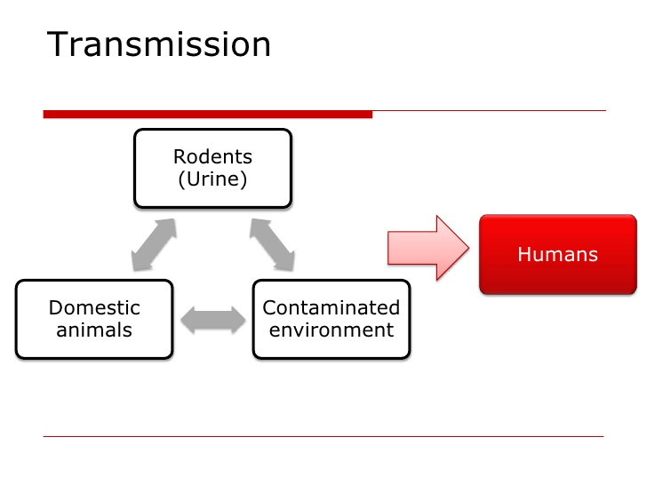
Transmission:
Through breaks in skin & mucous membranes in people dealing ē animals, which excrete leptospirae in urine.
Incubation period: 1-2 wks.
Variable febrile onset → spirochetes found in blood.

Slide 6
Pathogenesis:
Human infection results when leptospira ingested or through mucous membranes or skin.
Circulate in blood & multiply in various organs: Producing
Fever
Dysfunction of liver (jaundice)
Kidneys (uremia)
Lungs (hemorrhage)
Central nervous system (aseptic meningitis)

Slide 7
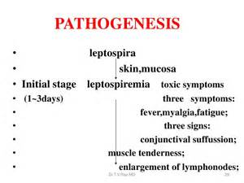

Slide 8
Clinical Features:
Illness typically biphasic:
First Phase: with fever, chills, intense headache & conjunctival suffusion (diffuse reddening of conjunctivae) appearing early in disease.
Followed by short period of resolution of symptoms as organisms cleared from blood.
Second Phase: “immune response” Characterized by:
Aseptic meningitis & in severe cases,
Liver damage (jaundice)
Impaired kidney function.
Human urine also contain spirochetes in 2-3 wks of infection.

Slide 9
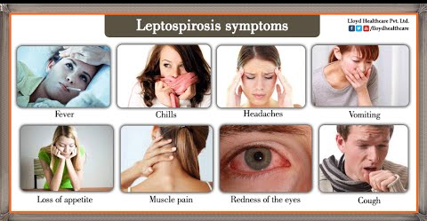
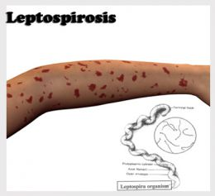

Slide 10
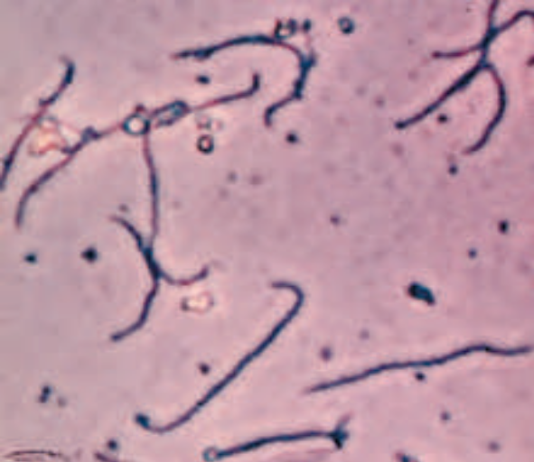
LAB DIAGNOSIS:
Diagnosis based on history of exposure & suggestive clinical signs
SPECIMEN:
Blood, CSF, Urine
MICROSCOPY:
Giemsa stain ē dark-field microscopy
Fluorescence-cojugated antibody

Slide 11
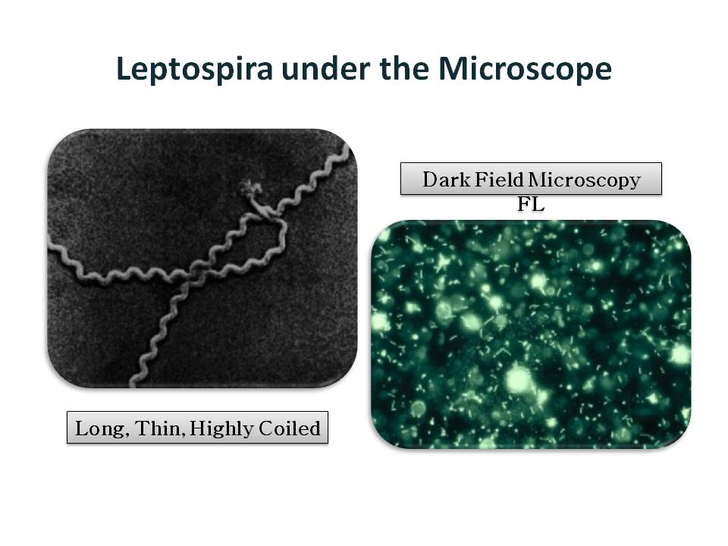

Slide 12
Culture: Isolated from blood & urine cultures
Aerobic condition, 28-30 °C, Semisolid Medium
SEROLOGY:
Agglutination test: Positive 5-7 days after infection
Marked rise in IgM-anti-body titers

Slide 13
Treatment & Prevention:
Treatment of choice penicillin G
No significant antibiotic resistance
Avoid contact with infected animals
Doxycycline effective in exposed persons

Slide 14
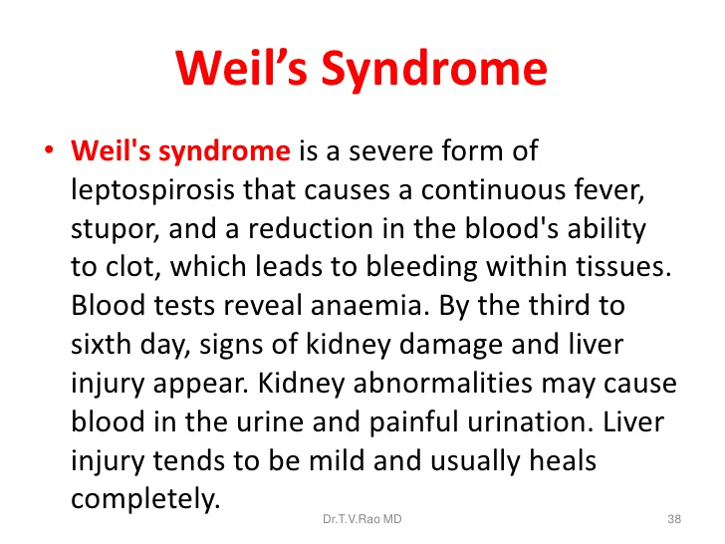

Slide 15
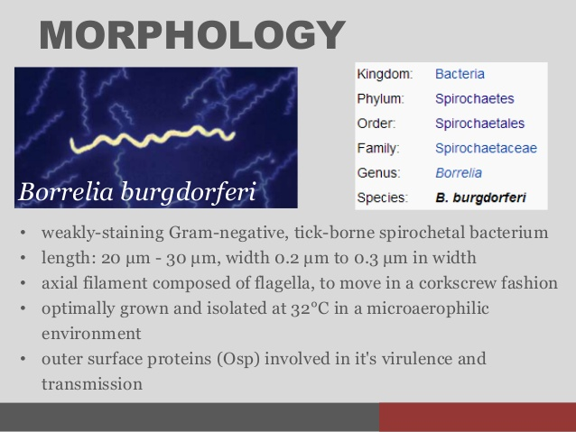
BORRELIA

Slide 16
Borrelia burgdorferi: Lyme disease (Lyme borreliosis)
Causes Lyme disease & relapsing fever
Most common tick-borne (vector borne) disease in United States
20,000 cases/year reported to CDC
Irregular, loosely coiled, flexible, motile spirochete
Visualized by dark field microscopy & Giemsa & silver stains
Cultured: Bacteriologic media containing serum or tissue extracts
Culture of organism from tick vector usually positive

Slide 17
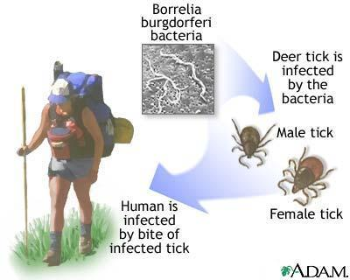

Slide 18
Epidemiology
Disease occurs worldwide
In United States, three regions primarily affected:
(states along North Atlantic seaboard, northern Midwestern states, e.g., Wisconsin, West Coast, especially California)
In 1996, 80% of reported cases occurred in New York, Connecticut, Pennsylvania & New Jersey

Slide 19
Major bacterial diseases transmitted by ticks
Lyme disease
Tularemia
Rocky Mountain spotted fever
Relapsing fever
Ehrlichiosis

Slide 20
Pathogenesis:
Incubation period: 3-10 days
FEBRILE STAGE: Sudden ē chills & abrupt rise in temperature, fever persists for 3-5 days & then declines. During this time, Spirochetes found in blood.
AFEBRILE STAGE
→4-10 days & then second attack of febrile stage
→3-10 such recurrences may result.
→During afebrile stage→ Spirochetes absent from blood.

Slide 21
Pathogenesis
Spread of organism from bite site through surrounding skin followed by dissemination via blood (bacteremia) to various organs, especially heart, joints & central nervous system.
No exotoxins, enzymes or other virulence factors.
Organism adapt to two different hosts, tick & mammal (either mice or humans).
It does so by changing its outer surface protein (OSP).
OSPs vary antigenically within humans & allow organism to persist for months to years.

Slide 22
Clinical Findings: Three stages:
Stage 1: Erythema chronicum migrans/ Erythema migrans, expanding erythematous macular rash with "target" or "bull's eye" appearance
Rash appears between 3 & 30 days after tick bite
Both tick bite & rash painless & non-pruritic
Non-nspecific "flulike" symptoms: fever, chills, fatigue & headache
Secondary skin lesions & arthralgias
In 25% of cases no rash seen

Slide 23
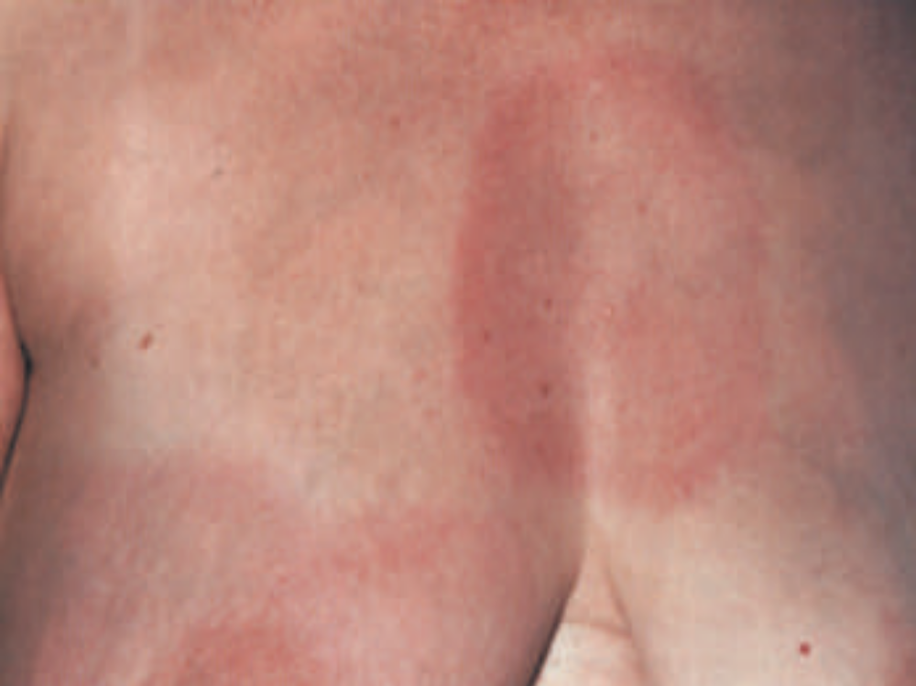

Slide 24
Stage 2:
Occurs weeks to months later
Cardiac & neurologic involvement
Myocarditis, accompanied by heart blocks
Acute (aseptic) meningitis & cranial neuropathies, facial nerve palsy (Bell's palsy)
Peripheral neuropathies
Latent phase lasting weeks to months

Slide 25
Stage 3:
Arthritis (large joints, knees). Autoimmune in origin
Chronic progressive central nervous system disease
Symptoms of fatigue, joint pains, or mental status changes

Slide 26
After few days → another variant attack → same process
Different antigenic varieties of Borrelia may be isolated from a single patient’s sequential relapses even after inoculation ē single organisms

Slide 27
Lab diagnosis:
SPECIMEN: Blood
MICROSCOPY: Thick or thin blood smears stained ē Giemsa or Wright stains → large, loosely coiled spirochetes among RBC’s.
CULTURE: Cultures rarely positive
Animal Inoculation:
White mice or rats inoculated intraperitoneally ē blood
2-4 days later, blood taken for examination

Slide 28
Serological Tests:
Enzyme-linked immunosorbent assay (ELISA) or an indirect immunofluorescence test:
Detects IgM antibody or rising titer of IgG antibody
IgM detectable 2 weeks after infection & peaks at 3 to 6 weeks
Western blot analysis: For confirmation of positive tests
PCR (polymerase chain reaction): Detects organism's DNA.

Slide 29
Treatment
Stage 1 disease: Doxycycline or amoxicillin
Stage 2 diseases: For more severe forms or late-stage disease, ceftriaxone
No significant antibiotic resistance

Slide 30
Prevention
Wearing protective clothing & use of insect repellents
Examining skin carefully for ticks (tick feed for 24 to 48 hours to transmit an infective dose)
Prophylactic antibiotics given in person bitten by a tick (Doxycycline)
Vaccine: Recombinant outer surface protein (OspA) of B. burgdorferi.

