Slide 1
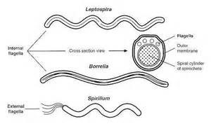
LEPTOSPIRA
Dr Sadia Ikram

Slide 2
Leptospira interrogans
Species | Disease | Mode of Transmission | Diagnosis | Morphology | Growth in Media | Treatment
Leptospira interrogans | Leptospirosis | Food or drink contaminated by urine of infected animals (rats, dogs, pigs, cows) | Serologic tests | Thin, tight spirals, seen by darkfield illumination | + | Penicillin G

Slide 3
Important Properties:
Leptospira interrogans cause of leptospirosis.
Divided into sero-groups that occur in different animals & geographic locations.
Each sero-group subdivided into serovars by response to agglutination tests.
Tightly coiled, fine spirochetes not stained with dyes, seen by dark field microscopy.
Grow in bacteriologic media containing serum.

Slide 4
Epidemiology:
Infect various animals, rats & other rodents, domestic livestock & household pets.
Reservoir: In United States, dogs most important reservoir.
Animals excrete leptospiras in urine, which contaminates water & soil.
Swimming in contaminated water or consuming contaminated food or drink can result in human infection.
Outbreaks have occurred among participants in adventure tours involving swimming in contaminated waters.
Miners, farmers, and people who work in sewers are at high risk.
Person-to-person transmission is rare.

Slide 5
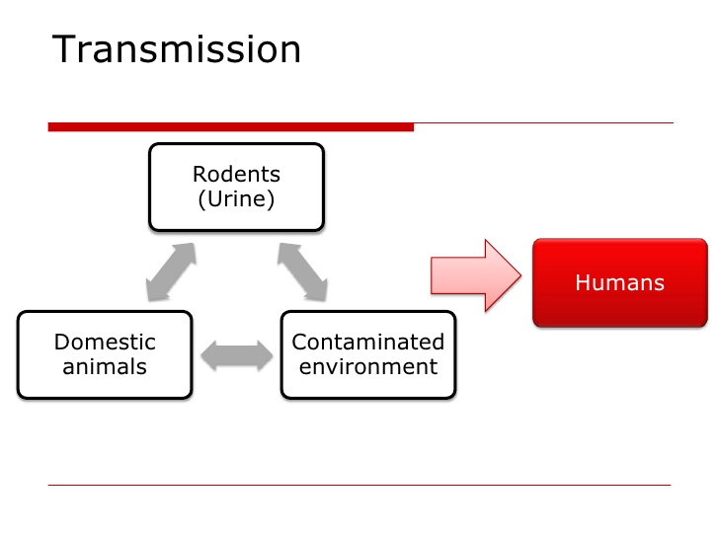
Transmission: Transmitted by:
i. Through breaks in skin & mucous membranes.
ii. Dealing ē animals, which excrete leptospirae in urine.
Incubation period = 1-2 wks.
Variable febrile onset → spirochetes found in blood.

Slide 6
Pathogenesis:
Human infection results when leptospiras ingested or pass through mucous membranes or skin.
They circulate in blood & multiply in various organs, producing fever and dysfunction of liver (jaundice), kidneys (uremia), lungs (hemorrhage) & central nervous system (aseptic meningitis).

Slide 7
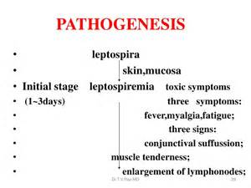

Slide 8
Clinical Features:
Illness typically biphasic, with fever, chills, intense headache & conjunctival suffusion (diffuse reddening of the conjunctivae) appearing early in disease, followed by a short period of resolution of these symptoms as organisms cleared from the blood.
Second Phase: "immune,"characterized by findings of aseptic meningitis & in severe cases, liver damage (jaundice) & impaired kidney function.

Slide 9
Then enter parenchymatous organs (Liver + Kidney) producing hemorrhage & necrosis → Organ dysfunction (jaundice, hemorrhage, nitrogen retention)
After initial improvement: 2nd Phase:
When IgM antibody titre ↑↑ → Manifests as “aseptic meningitis” ē intense headache, stiff neck.
Nephritis, hepatitis, skin, muscle & eye lesions can also occur.
Human urine also contain spirochetes in 2-3 wks of infection.

Slide 10
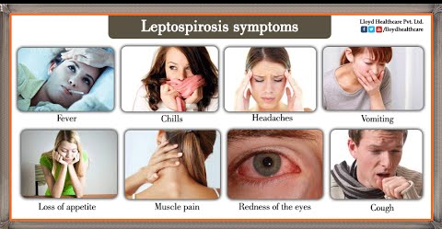
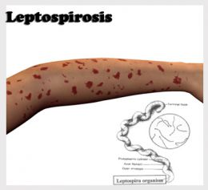

Slide 11
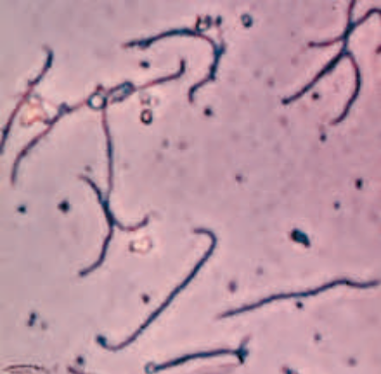
LAB DIAGNOSIS:
Diagnosis based on history of possible exposure, suggestive clinical signs.
SPECIMEN:
Blood, CSF, Urine.
MICROSCOPY:
Giemsa stain ē dark-field microscope.
Flouresceine-cojugated antibody can also use to detect infection.

Slide 12
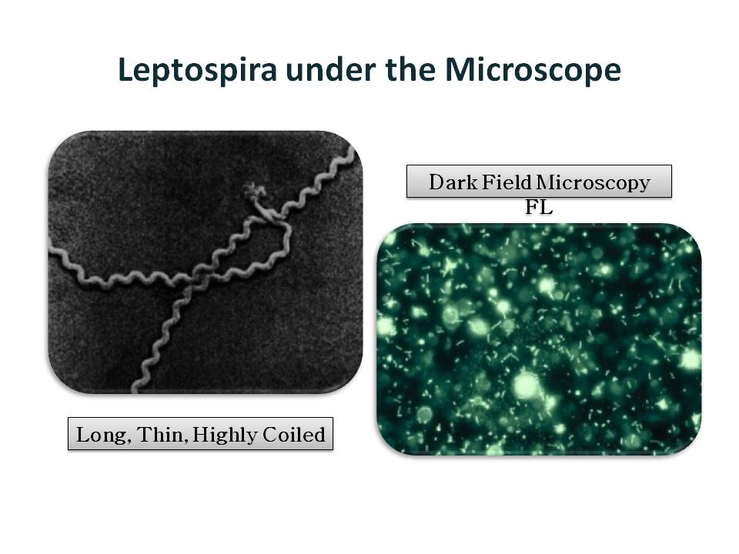

Slide 13
Culture: Isolated from blood & urine cultures.
Aerobic condition, 28-30 °C, Semisolid Medium.
Ellinghausen-McCullough-Johnson-Harris (EMJH) media.
SEROLOGY:
Agglutination test: Positive 5-7 days after infection.
Marked rise in IgM-anti-body titers.

Slide 14
Treatment:
Treatment of choice penicillin G.
No significant antibiotic resistance.
Prevention: Avoid contact with contaminated environment.
Doxycycline effective in exposed persons.

Slide 15
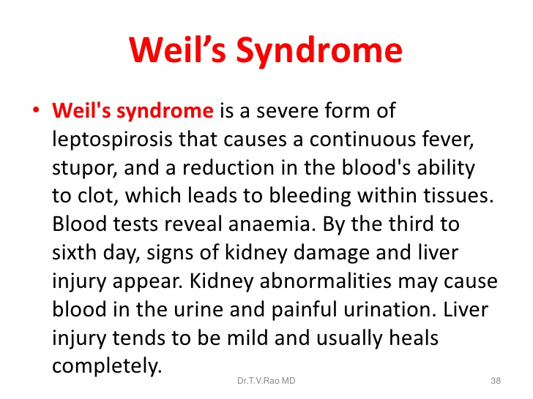

Slide 16
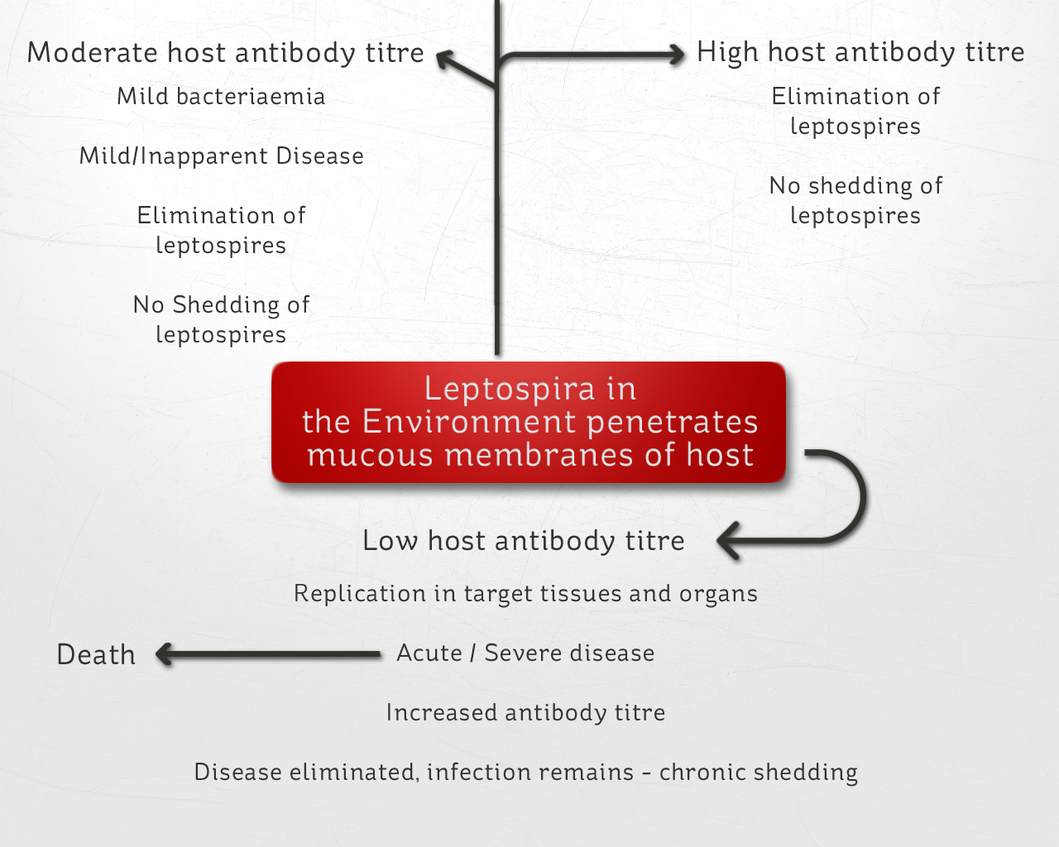

Slide 17
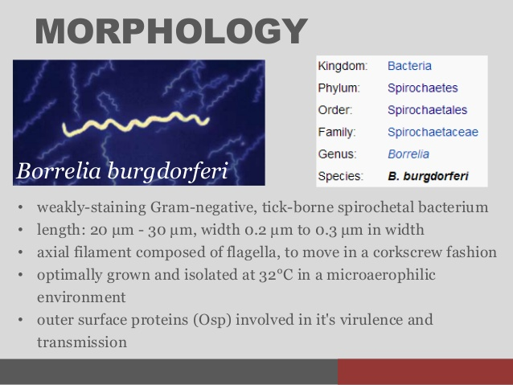
BORRELIA

Slide 18
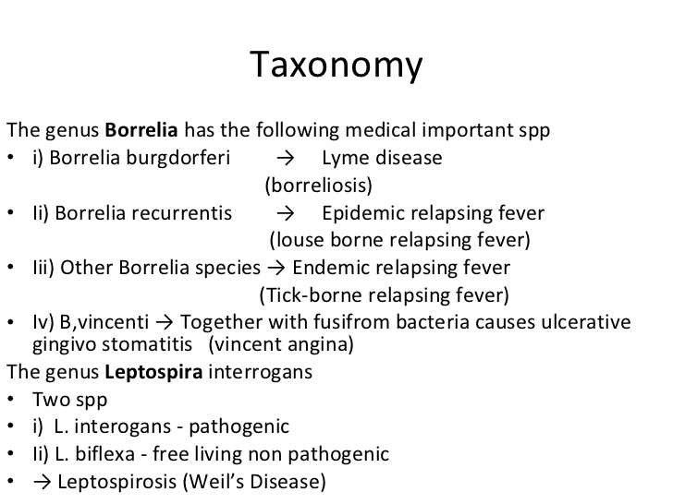

Slide 19
Borrelia burgdorferi: Lyme disease (Lyme borreliosis).
Causes Lyme disease & relapsing fever.
Most common tick-borne (vector borne) disease in United States.
20,000 cases/year reported to CDC.
Irregular, loosely coiled, flexible, motile spirochete
Visualized by dark field microscopy & Giemsa & silver stains.
Cultured: Bacteriologic media containing serum or tissue extracts.
Culture of organism from tick vector usually positive.

Slide 20
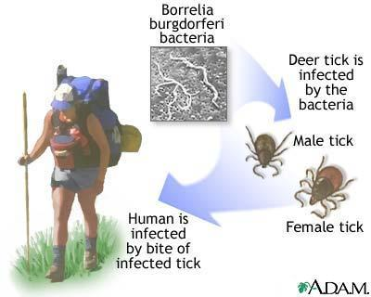

Slide 21
Epidemiology
Disease occurs worldwide.
In United States, three regions primarily affected: (states along North Atlantic seaboard, northern Midwestern states, e.g., Wisconsin, West Coast, especially California).
In 1996, approximately 80% of reported cases occurred in four states, New York, Connecticut, Pennsylvania & New Jersey.

Slide 22
Major bacterial diseases transmitted by ticks
Lyme disease.
Tularemia.
Rocky Mountain spotted fever.
Relapsing fever.
Ehrlichiosis.

Slide 23
Pathogenesis:
Incubation period: 3-10 days
FEBRILE STAGE: Sudden ē chills &abrupt rise in temperature, fever persists for 3-5 days & then declines. During this time, Spirochetes found in blood.
AFEBRILE STAGE
→4-10 days & then second attack of febrile stage
→3-10 such recurrences of diminish severity results.
→During a-febrile stage→ Spirochetes absent from blood.

Slide 24
Pathogenesis
Spread of organism from bite site through surrounding skin followed by dissemination via blood (bacteremia) to various organs, especially heart, joints & central nervous system.
No exotoxins, enzymes, or other important virulence factors.
Organism must adapt to two markedly different hosts, tick & mammal (either mice or humans).
It does so by changing its outer surface protein (OSP).
OSPs vary antigenically within humans & allow organism to persist for months to years.

Slide 25
Clinical Findings: Three stages:
Stage 1: Erythema chronicum migrans/ Erythema migrans, expanding, erythematous, macular rash with "target" or "bull's eye" appearance.
Rash appears between 3 & 30 days after tick bite.
Both tick bite & rash painless & non-pruritic.
Non-nspecific "flulike" symptoms: fever, chills, fatigue & headache.
Secondary skin lesions & arthralgias frequently occur..
In approximately 25% of cases of Lyme disease, no rash seen.

Slide 26
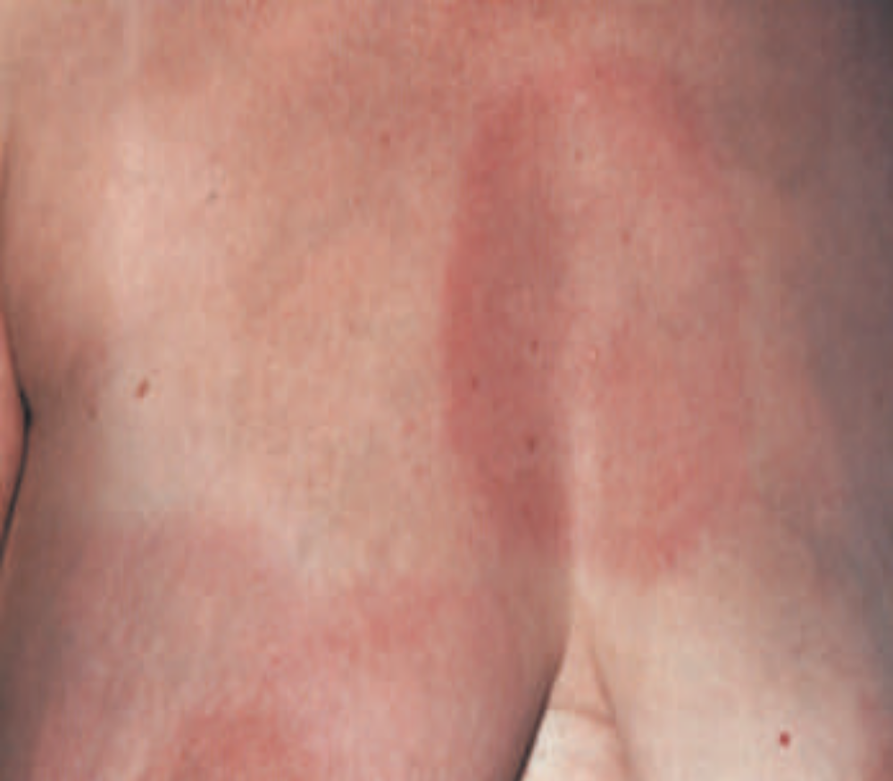

Slide 27
Stage 2:
Occurs weeks to months later.
Cardiac & neurologic involvement.
Myocarditis, accompanied by various forms of heart block.
Acute (aseptic) meningitis & cranial neuropathies, like facial nerve palsy (Bell's palsy).
Bilateral facial nerve palsy.
Peripheral neuropathies.
A latent phase lasting weeks to months.

Slide 28
Stage 3:
Arthritis (large joints, knees). Lyme arthritis autoimmune in origin.
Chronic progressive central nervous system disease.
Symptoms of fatigue, joint pains, or mental status changes.
No microbiologic evidence for infection detected in those patients & prolonged antibiotic therapy has not relieved symptoms.

Slide 29
After few days → another variant attack → same process.
Different antigenic varieties of Borrelia may be isolated from a single patient’s sequential relapses even after inoculation ē single organisms.

Slide 30
Lab diagnosis:
SPECIMEN: Blood
MICROSCOPY: Thick or thin blood smears stained ē Giemsa or Wright stains → large, loosely coiled spirochetes among RBC’s.
CULTURE: Cultures rarely positive.
Animal Inoculation:
White mice or rats are inoculated intraperitoneally ē blood. 2-4 days later, blood is taken for examination.

Slide 31
Serological Tests:
IgM antibody or rising titer of IgG antibody with an enzyme-linked immunosorbent assay (ELISA) or an indirect immunofluorescence test.
IgM detectable 2 weeks after infection & peaks at 3 to 6 weeks.
(Serologic tests done before 2 weeks yield negative results. After 30 days post-infection, tests for IgG more reliable).
Positive test result should be confirmed with Western blot analysis.
PCR (polymerase chain reaction): Detects organism's DNA.

Slide 32
Treatment
Stage 1 disease: Doxycycline or amoxicillin.
Stage 2 diseases: For more severe forms or late-stage disease, ceftriaxone.
No significant antibiotic resistance.

Slide 33
Prevention
Wear protective clothing & use of insect repellents.
Examining skin carefully for ticks (tick must feed for 24 to 48 hours to transmit an infective dose).
Prophylactic antibiotics given in person bitten by a tick depends on two main factors: Percentage of infected ticks in area & length of time tick has fed on the person.
Prescribe doxycycline prophylactically.
Vaccine: Recombinant outer surface protein (OspA) of B. burgdorferi as immunogen.

