Slide 1
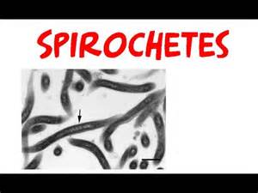
Dr Sadia Ikram
TREPONEMAS

Slide 2
Classification of Medically Important Bacteria Based on wall thickness
Bacteria
Rigid, thick walled
bacteria
Flexible, thin walled
bacteria
Wall-less bacteria
Free-living
(extracellular
bacteria)
Non-free-living
(obligate
intracellular
parasites)
Treponema
Leptospira
Borrelia
Mycoplasma

Slide 3
TREPONEMA:
INTRODUCTION:
Belongs to Spirochetaceae family
4 species (Treponema pallidium subspecies)
Treponema Pallidium Cause Syphilis
Treponema Pertenue Cause Yaws
Treponema Endemicum Cause Endemic Syphilis
Treponema Carateum Cause Pinta

Slide 4
Syphilis: Caused by Treponema Pallidium
TRANSMISSION: Transmitted by sexual contact.
Infectious lesion on skin & mucous membrane of genitalia.
Gram Negative stained by “Silver Staining Techniques”

Slide 5
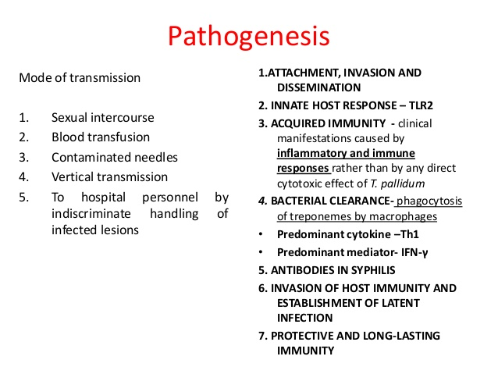

Slide 6
i) PRIMARY LESION:
Intra-rectal, perianal or oral or anywhere on body.
Enters by penetrating intact mucous membranes or through a break in epidermis (Skin).
Multiply locally at site of entry Spread to nearby lymph nodes & reach bloodstream within 2-10 weeks of infection Papule develops at site of infection Breakdown to form an ulcer ē clean, hard base (hard chancre) Heals spontaneously.
Inflammation Lymphocytes & Plasma cells predominate

Slide 7
ii)SECONDARY LESION:
After another 2-10 weeks of primary lesion, secondary lesion appears
Red maculopapular rash anywhere on body including hands & feet.
Moist, pale papules (condylomas) in anogenital region, axillae & mouth.
Involve CNS & CVS: causing Syphilitic meningitis, chorioretinitis, hepatitis, nephritis (complex immune reaction) periositis.

Slide 8
Primary & secondary lesion rich in spirochetes + highly infectious.
In 30% cases early syphilitic infection progresses to complete cure without treatment.
Another 30% Cases untreated infections remain latent (persist)
Another 60% cases Causes tertiary lesion.

Slide 9
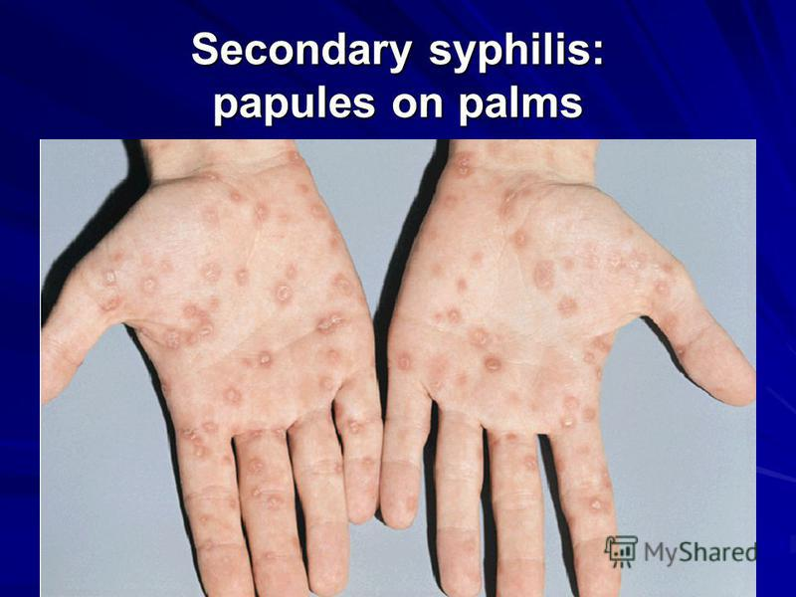

Slide 10
iii) TERTIARY LESION:
Development of Granulomatous lesion (GUMMAS) in skin, bones & liver.
Degenerative changes in CNS:
Meningo-vascular syphilis, Paresis, Tabes.
CVS lesion:
Aortitis, Aortic aneurysm, Aortic valve insufficiency.
In all tertiary lesions:
Treponemas rarely present, exaggerated tissue response contribute to hypersensitivity to organism.

Slide 11
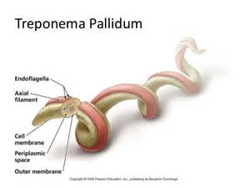
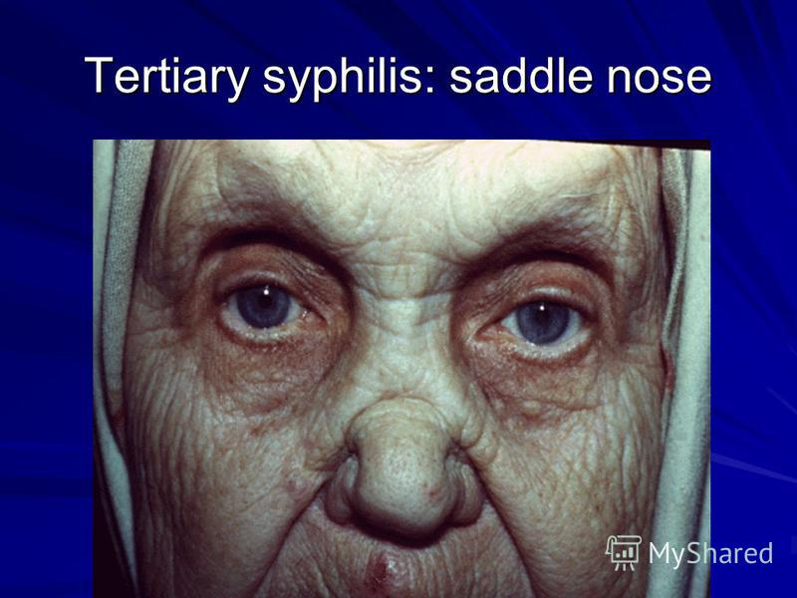
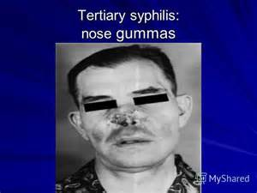

Slide 12
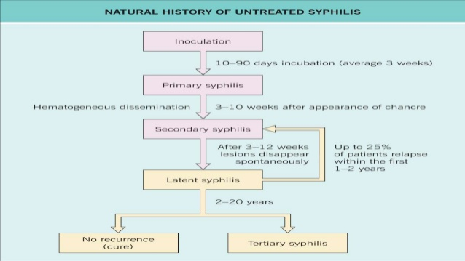

Slide 13
LAB DIAGNOSIS:
SPECIMEN: Tissue extract, blood, CSF from early surface lesion taken by pipette or swab.
MICOROSCOPY:
•Silver stains
•Silver Impregnation method
3. DARK FIELD MICROSCOPY:
A drop of tissue extract placed on a slide & cover it ē cover slip examined under oil-immersion lens within 20 min of collection ē dark field illumination for motile spirochete.
Disappear from lesion within a few hours after beginning of antibiotic treatment.

Slide 14
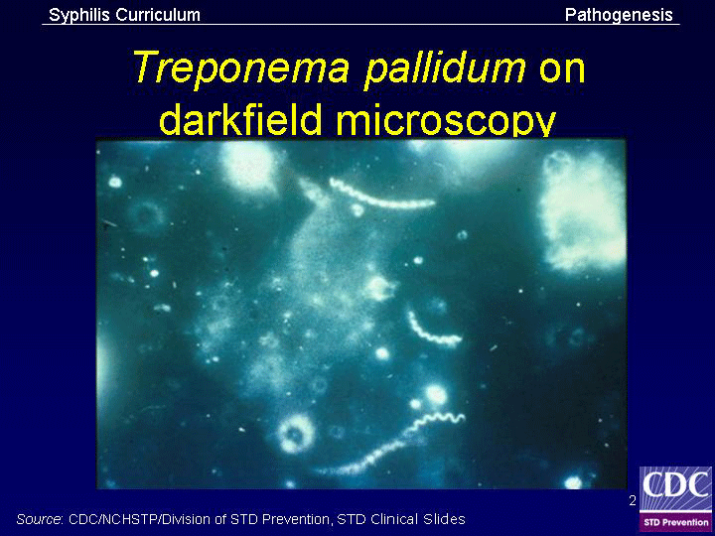

Slide 15
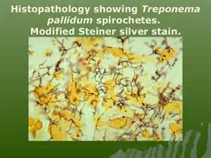

Slide 16
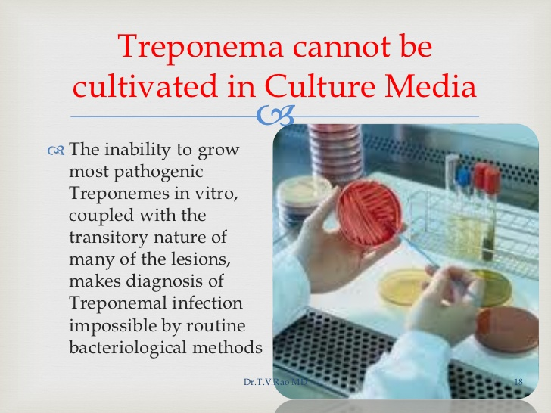
CULTURE:
CULTURE:
•Pathogenic Cannot be cultured
• Non-pathogenic Can be cultured

Slide 17
IMMUNOFLUORESCENCE: (INDIRECT)/ (SANDWICH TECHNIQUE)
Tissue extract stained ē fluorescein-labeled anti-treponeme antibody examined under fluorescense microscope apple green organisms glitters.
5. NUCLEIC ACID AMPLIFICATION TEST: (NAAT):
Done through (PCR) polymerase chain reaction.

Slide 18
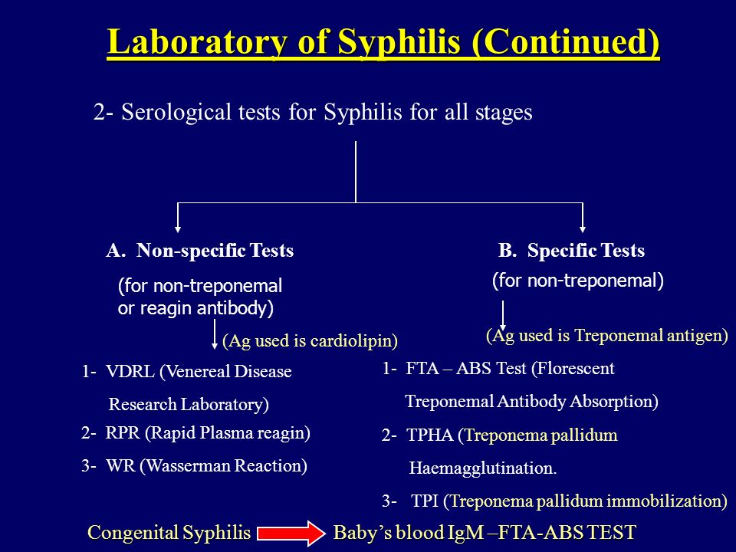

Slide 19
Nonspecific Serologic Tests
These tests involve use of nontreponemal antigens.
Extracts of normal mammalian tissues (e.g., cardiolipin from beef heart) react with antibodies in serum samples from patients with syphilis.
These antibodies are a mixture of IgG and IgM, called "reagin" antibodies.
Flocculation tests, e.g., VDRL (Venereal Disease Research Laboratory) and RPR (rapid plasma reagin) tests, detect the presence of these antibodies.
Positive in most cases of primary syphilis & almost always positive in secondary syphilis.
Titer of these nonspecific antibodies decreases with effective treatment. (specific antibodies positive for life)
False-positive reactions occur in leprosy, hepatitis B & infectious mononucleosis, positive results have to be confirmed by specific tests.
Used to determine response to treatment.
Used as a method of screening population for infection.

Slide 20
Specific Serologic Tests
These tests involve use of treponemal antigens & therefore more specific.
In these tests, T. pallidum reacts in immunofluorescence (FTA-ABS) or hemagglutination (TPHA, MHA-TP) assays with specific treponemal antibodies in the patient's serum.
Antibodies arise within 2 to 3 weeks of infection; therefore, test results positive in most patients with primary syphilis.
Tests remain positive for life after effective treatment & cannot be used to determine response to treatment or reinfection.
More expensive & more difficult to perform.
Not used as screening procedures.

Slide 21
TREATMENT:
Penicillin → Treatment of Choice
Syphilis <1 year duration → Single I/M injection of benzathine penicillin-G 2.4 millions units.
Older or latent syphilis → 3 times at weekly intervals.
Neurosyphilis → Large amount of I/V penicillin.

Slide 22
Jarisch-Herxheimer reaction
More than half of patients with secondary syphilis who are treated with penicillin experience fever, chills, myalgias & other influenza like symptoms a few hours after receiving antibiotic.
Response is Jarisch-Herxheimer reaction.
Occur due to lysis of treponemes & release of endotoxin-like substances.
Patients should be alerted to this possibility, may last for up to 24 hours & symptomatic relief can be obtained with aspirin.

Slide 23
Prevention
Prevention depends on early diagnosis & adequate treatment, use of condoms, administration of antibiotic after suspected exposure, and serologic follow-up of infected individuals and their contacts.
Presence of any sexually transmitted disease makes testing for syphilis mandatory, because several different infections are often transmitted simultaneously.
No vaccine against syphilis.

Slide 24
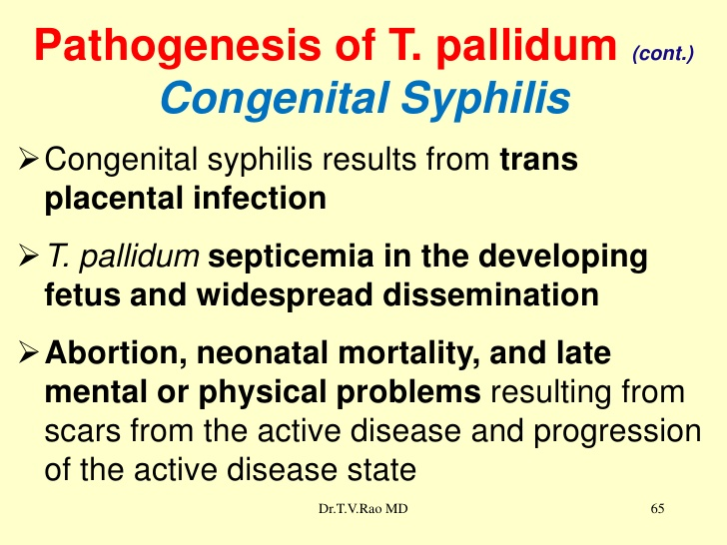

Slide 25
BEJEL:
Caused by T.pallidium subspecies endemicum.
Common in children.
Produce highly infectious skin lesions, after latent period of infection → destruction of bony & cartilaginous structures + chronic skin ulceration.
Penicillin → Drug of choice.

Slide 26
YAWS:
Caused by T.pallidium sub-species pertenue.
In children, in humid & hot climate
Transmitted by person-to-person contact in children < 15 years.
Primary lesion → ulcerating papules.
Scar formation of skin lesions & bone destruction are common.

Slide 27
PINTA:
Caused by T.pallidum subspecies carateum.
Restricted to dark-skinned people.
Primary lesion → Non-ulcerating papule on exposed areas.
Later → Hyper pigmented lesions on skin.
Further → Depigmentation & Hyperkeratosis after few years.
Transmitted by non-sexual means.

